Slide 1
The Human Eye
6th Grade Science

Slide 2
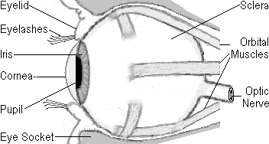
Parts of the Eye
Lens
Eyelid
Sclera
Eyelashes
Orbital
Muscles
Iris
Cornea
Optic Nerve
Pupil
Eye Socket

Slide 3
Cornea
Clear covering over the eye

Slide 4
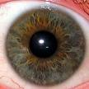
Iris
Circular band that controls how much light enters the eye
Gives eyes their color
Examine your partner’s eyes with the lights off and then with the lights on.
What do you notice?

Slide 5
Lens
Tissue that bends (refracts) light passing through and helps focus an image

Slide 6
Pupil
Hole in the center of the eye which allows light to pass through
Why do optometrist dilate your eyes?

Slide 7
Sclera
White part of the eye
Protects the eye

Slide 8
Retina
Layer of tissue on the back of the eye that has cone and rod cells which gather information
Rods: allow us to see black, white, & shades of grey
Cones: allow us to see red, blue, and green colors
They work together so we can see many shades of colors

Slide 9
Optic Nerve
Nerve that connects the eye to the brain

Slide 10
Eyelid & Eyelashes
Covers & protects the eye

Slide 11
Orbital Muscles
Allow eyes to move
Humans are the only animal who can “roll” their eyes

Slide 12
Media Clip

Slide 13
How do we see?
1. Light enters the eye through the cornea.
2. Light continues through the pupil which is controlled by the iris.
3. Light passes through the lens which refracts (bends) the light causing the picture to be upside down.
4. The upside down picture travels to the retina which flips the image right side up.
5. The optic nerve sends signals to the brain, which interprets the images.

Slide 14
Eye Fun Facts
Most people blink every 2-10 seconds.Each time you blink, you shut your eyes for 0.3 seconds, which means your eyes are closed at least 30 minutes a day just from blinking.
Owls can see a mouse moving over 150 feet away with light no brighter than a candle.
The reason cat's and dog's (and cow’s) eyes glow at night is because of silver mirrors in the back of their eyes called the tapetum. This makes it easier for them to see at night.
An ostrich has eyes that are two inches across. Each eye weighs more than their brain.
A chameleon's eyes can look in opposite directions at the same time.
A newborn baby sees the world upside down because it takes some time for the baby's brain to learn to turn the picture right-side up.
One in every twelve males is color blind

